Slide 1



ABMSP'S
Anantrao Pawar College of Engineering & Research
A
Project Review (Stage II)
On
“DEEFLYZER : HYBRID MODEL TO DETECT COMPLEX DEEPFAKE IN DIGITAL MEDIA”
PRESENTED BY
SOHAM KOLAPKAR Seat No: B401100154
RIYA KSHIRSAGAR Seat No: B401100155
CHARUDATTA THAKARE Seat No: B401100190
SHANTANU SHINDE Seat No: B401100178
Under the Guidance of
DR. JITENDRA MUSALE
Department of Computer Engineering
Savitribai Phule University
A.Y. - 2024-25

Slide 2
Content:
Problem Definition
Aim & Objectives
Introduction
Literature Survey
Methodology
Result & Discussions
Conclusion
References
Publication Details

Slide 3
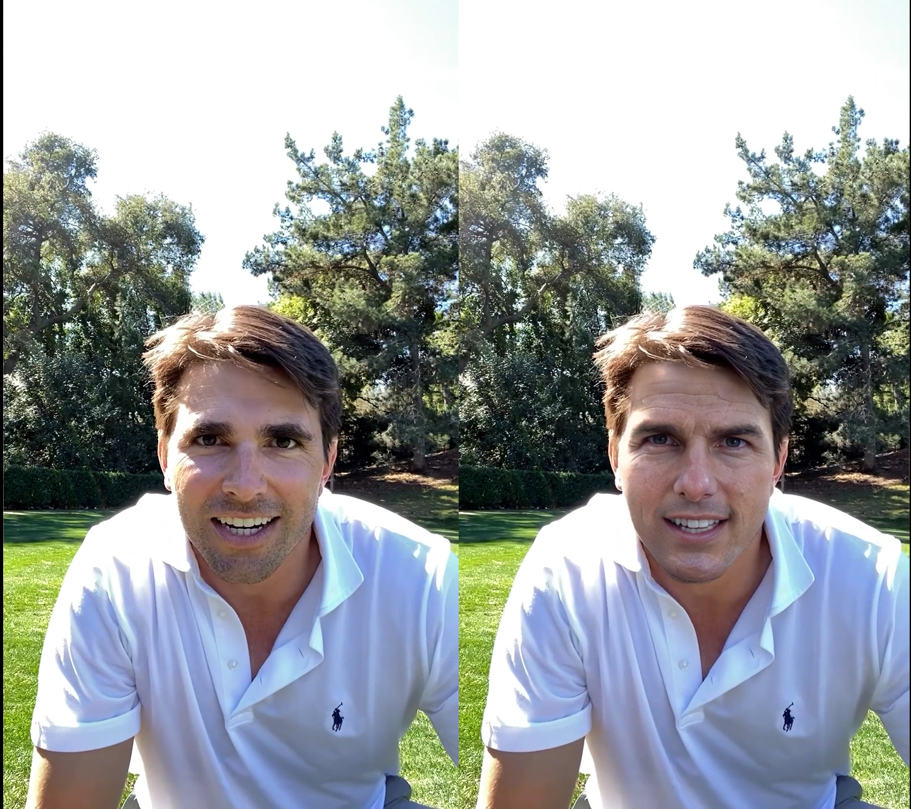
Problem Statement
The proliferation of deepfake technology powered by GANs has made it increasingly difficult to distinguish between real and synthetic media.
This presents severe challenges, including:
Misinformation and fake news,
Identity theft and fraud,
Political manipulation,
Cybersecurity threats.
Challenge: Traditional detection methods struggle to keep pace with advanced deepfake generation techniques, calling for a hybrid, multi-modal, AI-powered detection system.

Slide 4
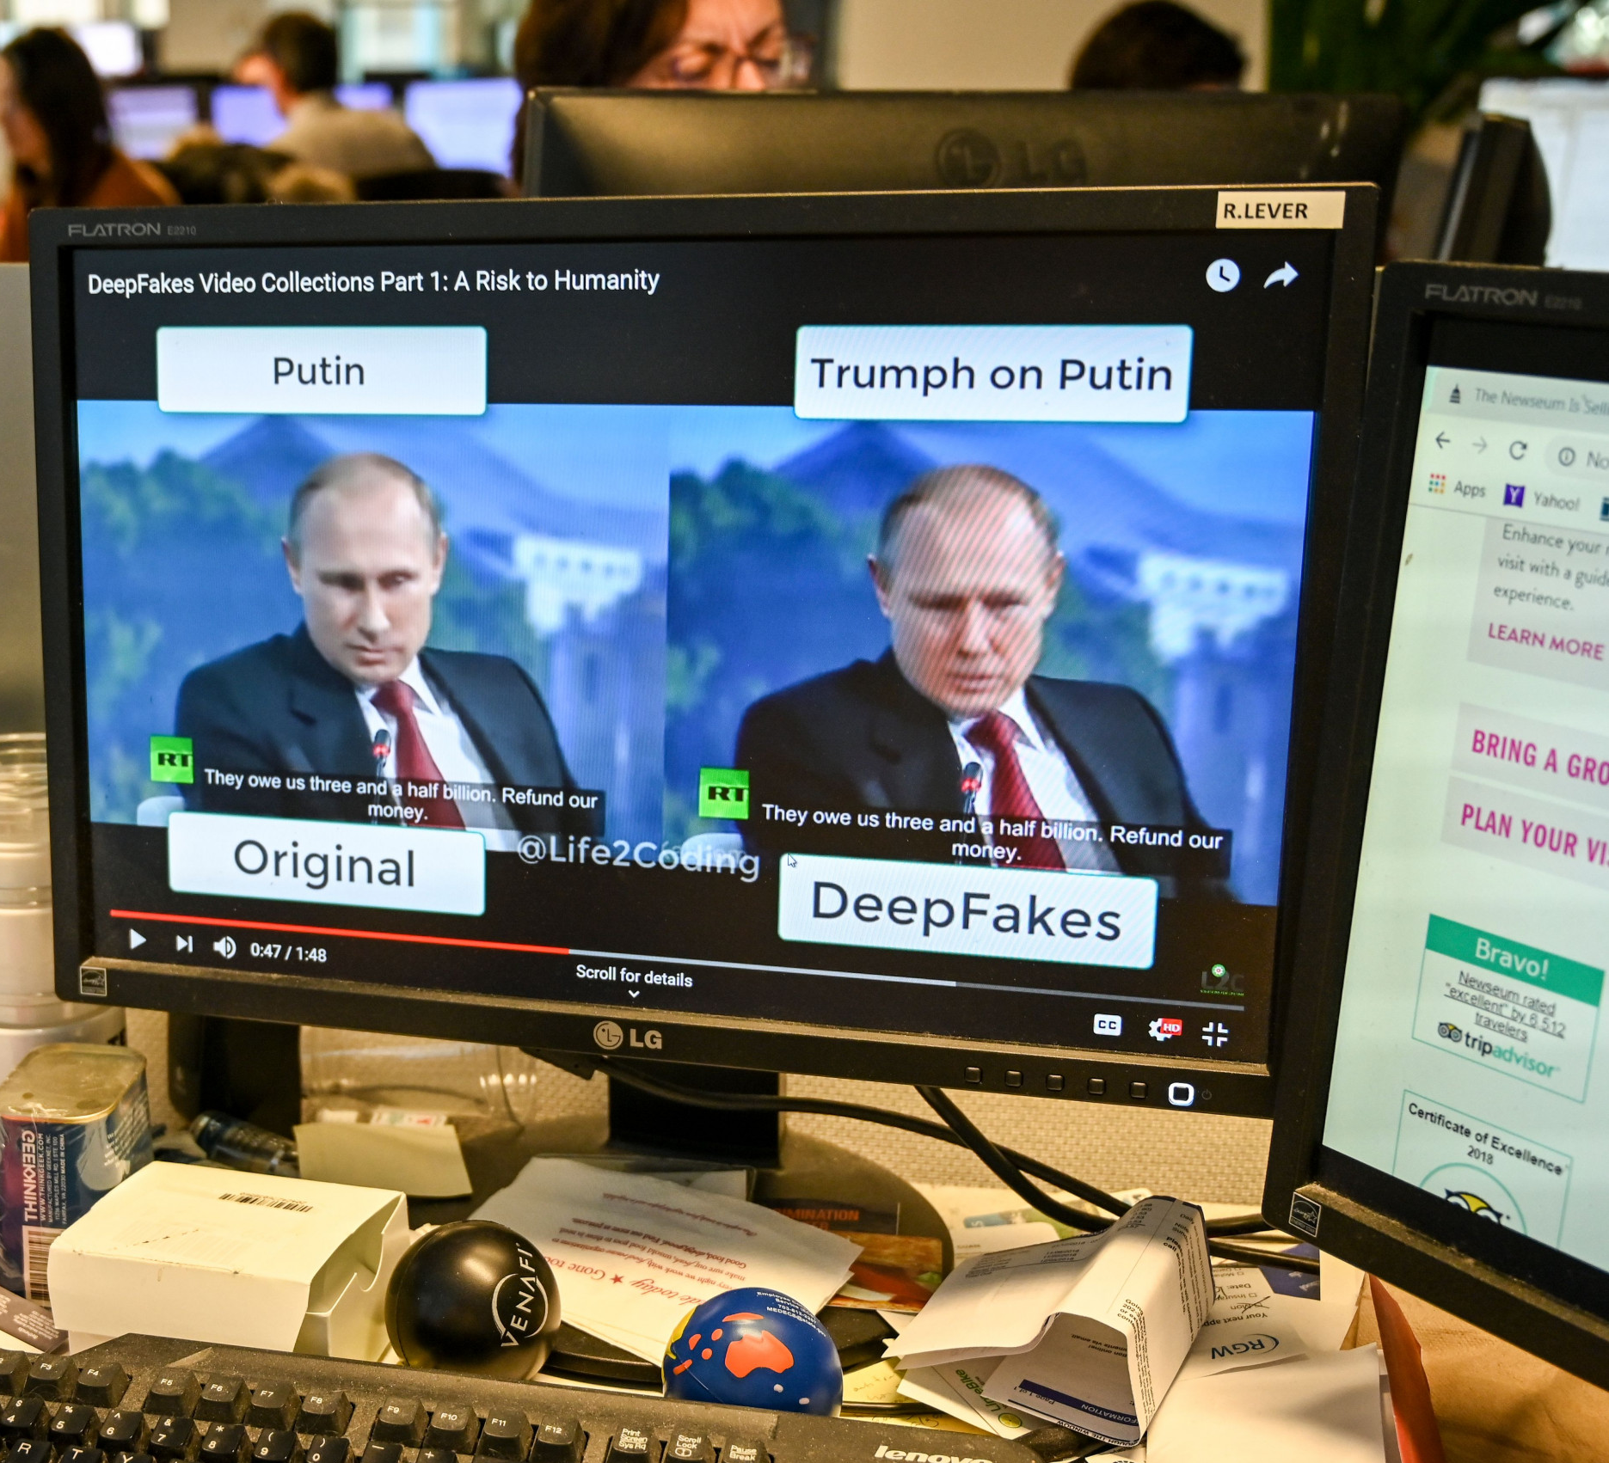
Aims & Objectives
Aim:
To develop a hybrid AI-based system that detects deepfake content using both video and audio modalities for accurate and interpretable classification.
Objectives:
Build a InceptionV3 + LSTM model for video deepfake detection.
Use Wav2Vec 2.0 to detect audio deepfakes.
Incorporate face localization for visual manipulation.
Achieve classification accuracy >96% on benchmark datasets.
Develop an interactive web interface for real-time detection.

Slide 5
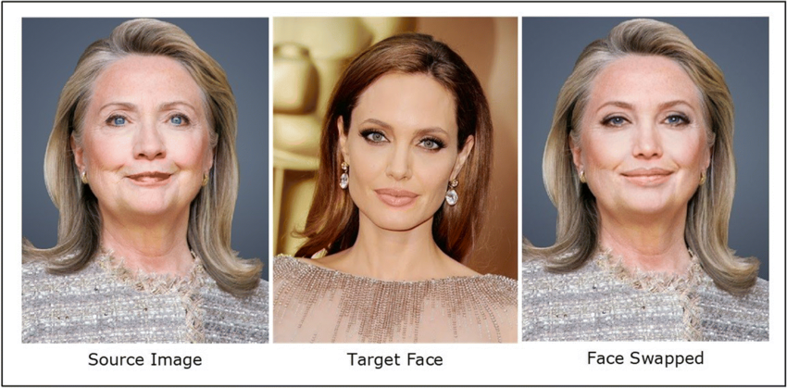
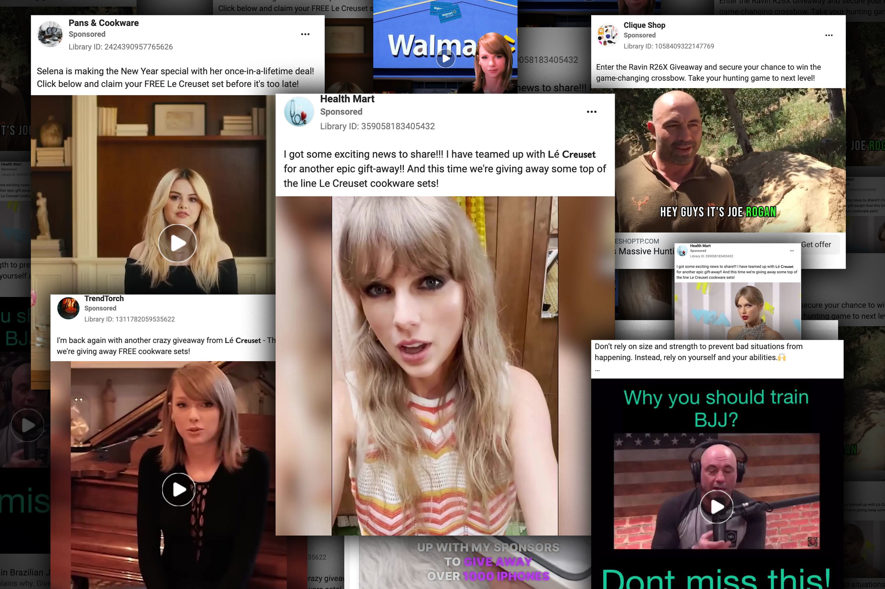
Introduction:
Deepfake media poses a growing threat to digital integrity, social trust, and cybersecurity.
With AI-generated content becoming more realistic, it’s crucial to design systems that can:
Detect fake visual and audio media,
Provide localized evidence of manipulation,
Scale to various real-world applications including journalism, digital forensics, and social media moderation.
Deeflyzer addresses this with a dual-path hybrid model integrating InceptionV3 + LSTM and Wav2Vec 2.0.

Slide 6
Literature Survey:
Sr. No. | Paper Name | Year | Scopus | Challenges
1. | Boosting Deepfake Detection Generalizability via Expansive Learning and Confidence Judgement | 2024 | IEEE | Not Suitable for all Deepfake Generation Techniques
2. | Deep Fake Detection using Adversarial Ensemble Techniques | 2024 | IEEE | Prone to Adversarial Attacks
3. | Audio Deepfake Detection and Classification | 2024 | IEEE | Cannot Classify AI Generated Voice
4. | Dynamic and Static Features Extraction for Deepfake Detection | 2024 | IEEE | Feature Extraction Varies due to Video Condition
5. | A Face Forgery Video Detection Model Based on Knowledge Distillation | 2024 | IEEE | Computational Cost reduction affecting accuracy
6. | Deepfake Classification for Human Faces using Custom CNN | 2024 | IEEE | Inefficiency of datasets

Slide 7
Literature Survey:
Sr. No. | Paper Name | Year | Scopus | Challenges
7. | Contrastive Learning for DeepFake Classification and Localization via Multi-Label Ranking | 2024 | IEEE | Localization causes excessive computational cost
8. | Preserving Fairness Generalization in Deepfake Detection | 2024 | IEEE | Bias in deepfake detection models with unfair performance
9. | Exploiting Style Latent Flows for Generalizing Deepfake Video Detection | 2024 | IEEE | Poor adaption to unseen deepfake techniques
10. | Rethinking the Up-Sampling Operations in CNN-Based Generative Network for Generalizable Deepfake Detection | 2024 | IEEE | CNN-based up-sampling introduces artifacts that may affect detection models
11. | AVFF: Audio-Visual Feature Fusion for Video Deepfake Detection | 2024 | IEEE | Cannot perform well when combined and no localization
12. | Spatial Vision Transformer: A Novel Approach to Deepfake Video Detection | 2024 | IEEE | High Computational Costs

Slide 8
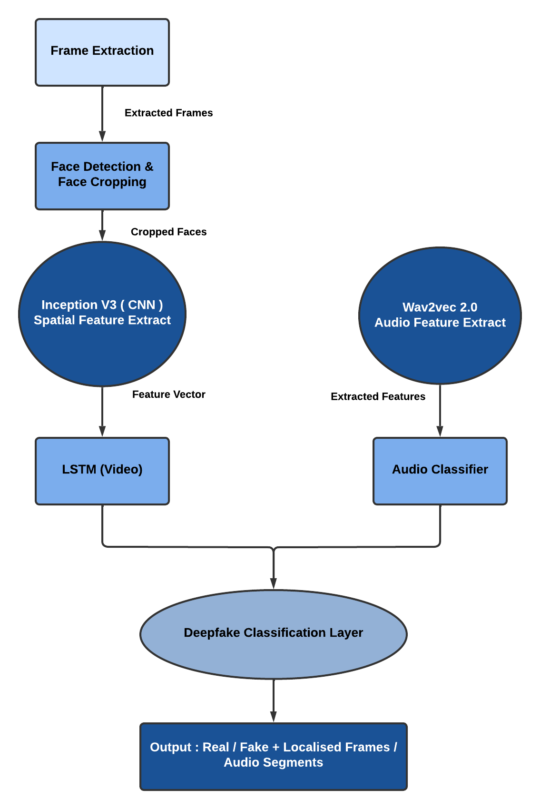
Methodology:
Video Deepfake Detection:
Frame Extraction
InceptionV3 (CNN): Spatial feature learning
LSTM (RNN): Temporal feature modeling
Output: Binary classification (Real/Fake)
Audio Deepfake Detection:
Audio Preprocessing (Waveform)
Wav2Vec 2.0 (Transformer): Latent speech embedding
Output: Real or Fake classification
System Features:
Media upload via web interface (NextJS)
Real-time classification via FastAPI backend
Localization of manipulated facial frames

Slide 9
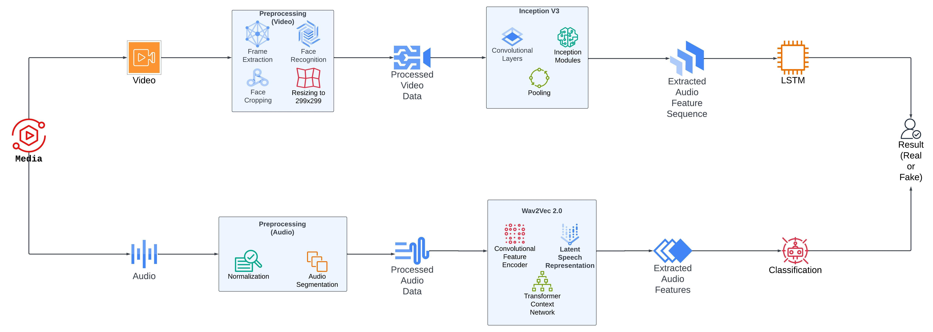
Flow Diagram:

Slide 10
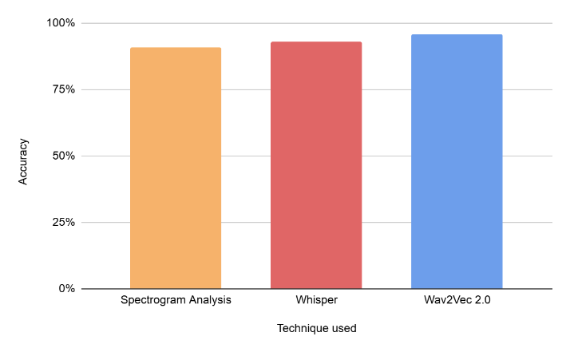
Results
Model | Dataset Used | Performance Metric
 |  | Accuracy | Precision | Recall
InceptionV3+ LSTM | DFDC | 96.17% | 89.11% | 91.1%
 | FF++ | 95.11% | 87.45% | 86.5%
 | Celeb-DF | 95.43% | 88.15% | 84.1%
EfficientNet+ LSTM | DFDC | 95.64% | 82.41% | 83.2%
 | FF++ | 93.24% | 83.17% | 82.4%
 | Celeb-DF | 96.09% | 85.72% | 84.6%
ResNet+ LSTM | DFDC | 91.79% | 82.64% | 87.8%
 | FF++ | 89.44% | 84.54% | 82.7%
 | Celeb-DF | 93.82% | 87.15% | 89.4%
Video Detection Accuracy (InceptionV3 + LSTM): 96.17%
Audio Detection Accuracy (Wav2Vec 2.0 on ASVSpoof 2019): 96%
Localization Feature: Identifies tampered regions in video/audio

Slide 11


Outputs

Slide 12

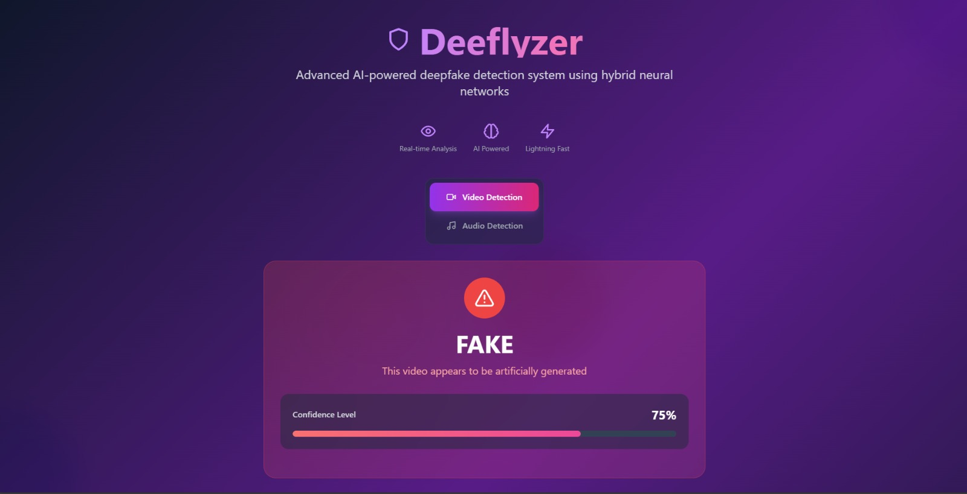
Results

Slide 13
Conclusion
A hybrid deepfake detection framework combining state-of-the-art models for both audio and video has been presented.
The dual-modality detection increases robustness and accuracy.
Localization allows forensic insight by visually or acoustically marking fake segments.
The model demonstrated high accuracy on real-world datasets like DFDC and ASVSpoof 2019, showing its applicability in practical security systems.

Slide 14
References
[1] Tong Qiao, Shichuang Xie, Yanli Chen, Florent Retraint, Xiangyang Luo “Fully Unsupervised Deepfake Video Detection via Enhanced Contrastive Learning” IEEE Transactions on Pattern Analysis and Machine Intelligence (Volume: 46, Issue: 7, July 2024)
[2] Yinlin Guo, Haofan Huang, Xi Chen, He Zhao, Yuehai Wang “Audio Deepfake Detection with Self-Supervised Wavlm and Multi-Fusion Attentive Classifier” 2024 IEEE International Conference on Acoustics, Speech and Signal Processing (ICASSP)
[3] Manoj Kumar, Praveen Kumar Rai, Pankaj Kumar “A Novel Approach for Detecting Deepfake Face Using Machine Learning Algorithms” 2024 2nd International Conference on Disruptive Technologies (ICDT)
[4] Huimin She, Yongjian Hu, Beibei Liu, Jicheng Li, Chang-Tsun Li “Using Graph Neural Networks to Improve Generalization Capability of the Models for Deepfake Detection” IEEE Transactions on Information Forensics 10.1109/TIFS.2024.
[5] Lam Pham, Phat Lam, Truong Nguyen, Huyen Nguyen, Alexander Schindler “Deepfake Audio Detection Using Spectrogram-based Feature and Ensemble of Deep Learning Models” 2024 IEEE 5th International Symposium on the Internet of Sounds (IS2)
[6] M Sivabalamurugan, T R Swapna “Deepfake detection and classification using local surface geometrical features” 2024 IEEE International Conference on Computer Vision and Machine Intelligence (CVMI)
[7] Amidela Anil Kumar, S J Dheepthi Priyangha, P Meghana, Muppalla Dheeraj, R Aarthi “XAI – Empowered Ensemble Deep Learning for Deepfake Detection” 2024 15th International Conference on Computing Communication and Networking Technologies (ICCCNT)
[8] Daeun Song, Nayoung Lee, Jiwon Kim, Eunjung Choi “Anomaly Detection of Deepfake Audio Based on Real Audio Using Generative Adversarial Network Model” Open Access IEEE
[9] Xiaoke Yang, Haixu Song, Xiangyu Lu, Shao-Lun Huang, Yueqi Duan “AdaForensics: Learning A Characteristic-aware Adaptive Deepfake Detector” 2024 IEEE International Conference on Multimedia and Expo 10.1109/ICME57554.2024.10687869 (ICME)
[10] Atharva Kohapare, Karan Dhongade, Rahul Sukare, Priya Maidamwar “Implementation of Deep Learning Method for Forgery Detection on Social Media” 2024 2nd International Conference on Intelligent Data Communication Technologies and Internet of Things (IDCIoT)

Slide 15
Publication Details
Conference: ICAAAI 2025 (International Conference on Advances and Applications in AI)
Paper Title: “Deeflyzer: A Hybrid Multi-Modal Model for Deepfake Detection”
Status: Submitted, awaiting review
Plagiarism Check: Cleared
Conference: 3rd IEEE International Conference on Knowledge Engineering and Communication Systems ( ICKECS) , SJC Institute of Technology , Bangalore
Paper Title: “Deeflyzer: Enhancing Media Integrity Through Advanced Deepfake Detection”
Status: Submitted, awaiting review
Plagiarism Check: Cleared

Slide 16
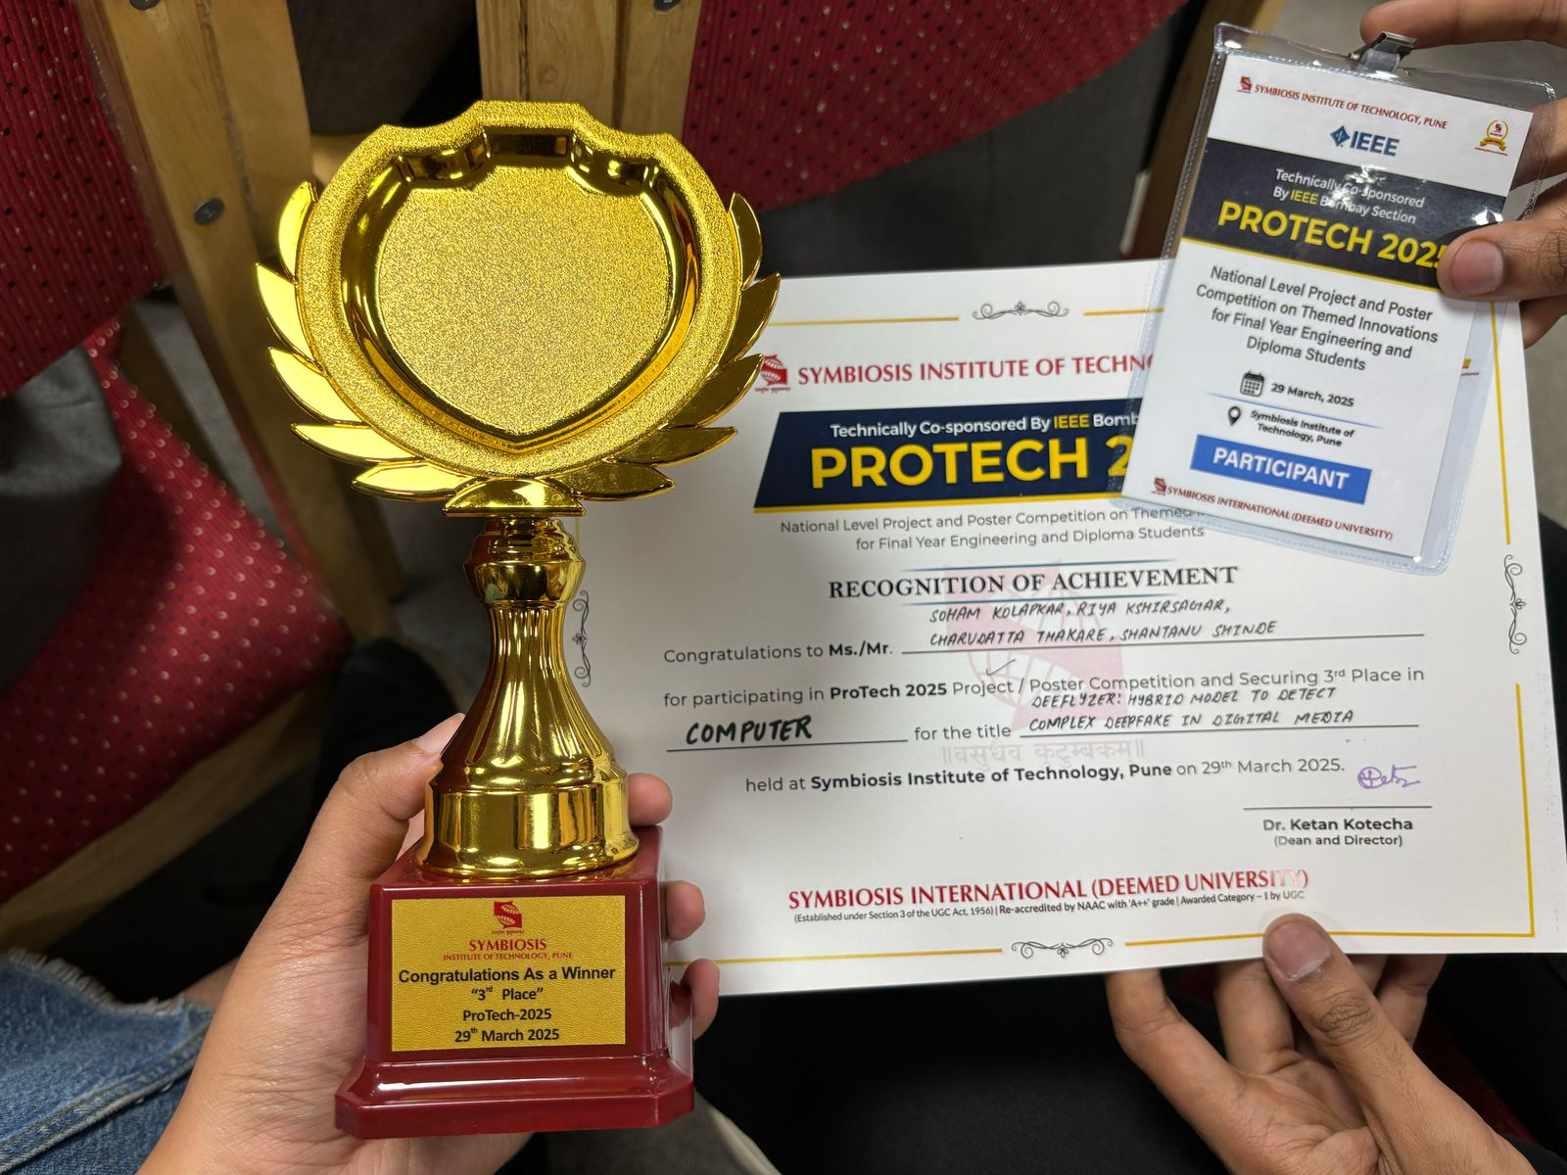
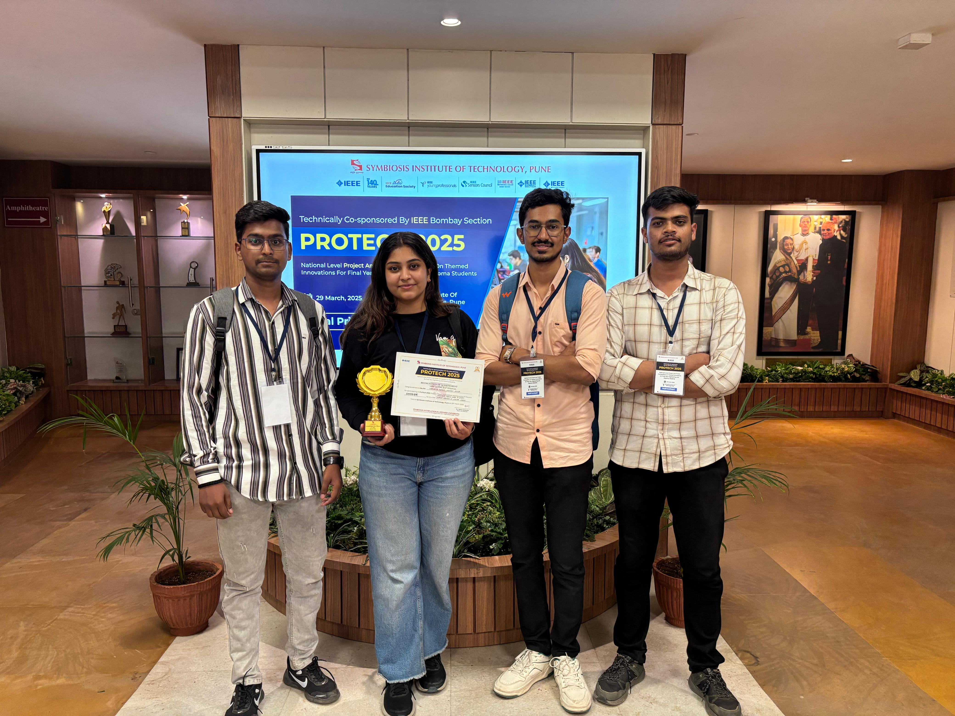
Achievement
SYMBIOSIS INSTITUTE OF TECHNOLOGY
2nd Runner UP

Slide 17
THANK YOU

